Slide 1
Final project:
LoRA Training
Dylan O’Neill

Slide 2
Intro to Stable Diffusion

Slide 3
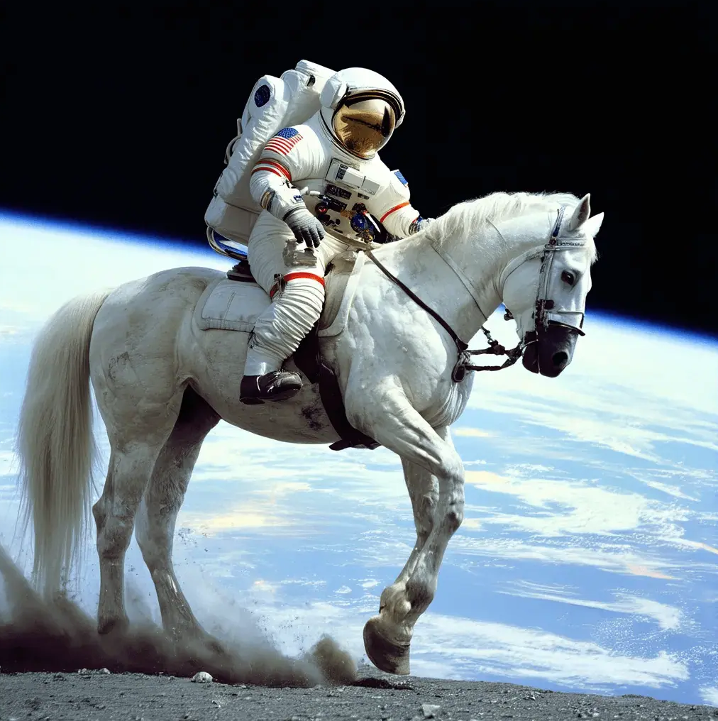
Stable Diffusion
Stable Diffusion is a deep learning model originally developed to take text based prompts and turn them into images
This is done by compiling billions of images and feeding them into a large neural network
This leads to one model being able to generate a wide variety of images from a vast user input
https://en.wikipedia.org/wiki/Stable_Diffusion#/media/File:Astronaut_Riding_a_Horse_(SD3.5).webp
https://www.geeksforgeeks.org/stable-diffusion/

Slide 4
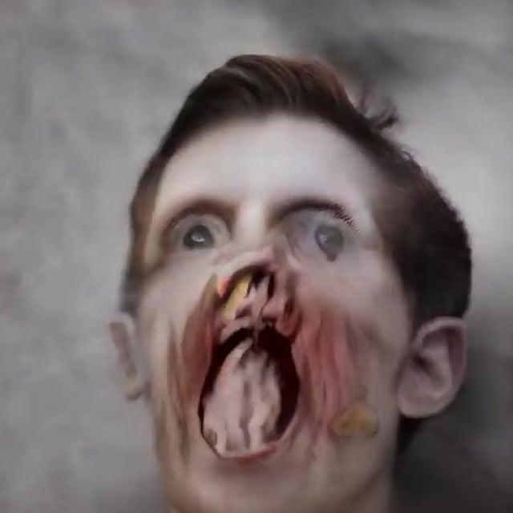
Stable Diffusion cont.
There is a cost to this approach: Lack of specificity and large file sizes
The base SD 1.5 model is 4.85GB (and that’s the pruned model, The original is over 8GB!)
Even generic cases (see on the right) can lead to less than desirable results from merely using the generic model
https://www.reddit.com/r/creepy/comments/l4xid3/some_ai_generated_faces/#lightbox
https://www.geeksforgeeks.org/stable-diffusion/

Slide 5
Stable Diffusion cont. cont.
This led many people in 2022 to write off AI generated images entirely, deducing that the time needed to get a half-decent image wasn’t worth it
It was simple, using only generalised models, you were never going to get good, specific results without models being larger than the available space on people's hard drives
Cloud Computing
Long term doubts that this technology would have staying power
https://medium.com/@junehao/comparing-ai-generated-images-two-years-apart-2022-vs-2024-6c3c4670b905

Slide 6
Introducing: LoRAs

Slide 7
Origin of LoRAs
LoRAs came from a paper published in March 2022 from a team of researchers at Microsoft with the goal of reducing GPU compute needed to augment existing natural language processors (Using an early version of ChatGPT as their base)
Microsoft wanted to prevent having to retrain an entire model while only making minor changes and tweaks to suit a specific need
Cloud computing costs are high
Economic Opportunity Loss can be quite large (Lucrative cloud computing market)
Since then, LoRAs have become the defacto way of making minor additions on top of existing deep learning models
Portability - A LoRA trained on one model can be used on many others
File size - Most LoRAs are a fraction of the size of large deep learning models
https://openreview.net/pdf?id=nZeVKeeFYf9

Slide 8
Summary of my project
I trained a Stable Diffusion LoRA using Kohya_ss to train my model based on my dog, Juneau
I wanted to see how effective a LoRA could be trained on a non-human subject, while being able to actually see how well a LoRA could actually replicate a specific , singular being while keeping a limited file size

Slide 9
The process behind training the model

Slide 10
Dataset
I collected my data from photographs taken by myself and my family
Almost all were taken on phones with a vertical camera position
Wanted to keep the file size low ⇒ Use a limited number of photos
I ended up using a mere 16 curated images for my model out of a possible pool of 104
Tough to curate an image set for a dog
Dogs tend to be bad at posing for pictures…
How do you choose to capture her?
Mix of pictures from when she was a puppy and now?
All from one specific time frame?

Slide 11
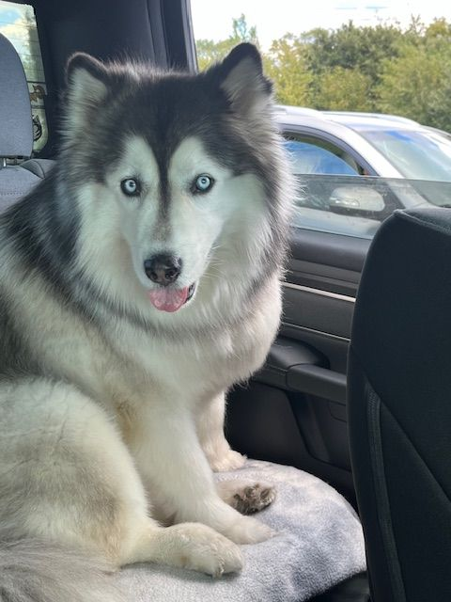

Kohya_ss: How pictures turn to Stable Diffusion LoRAs
Kohya_ss is a tool to take images and captioned prompts and use them as inputs to help train a LoRA based on a specific Stable Diffusion model
In my case, I took the base SD 1.5 as the base model
I then took my curated photos and made short prompts to help associate keywords with the photo (16 photos with captions)
(Real Photo)

Slide 12
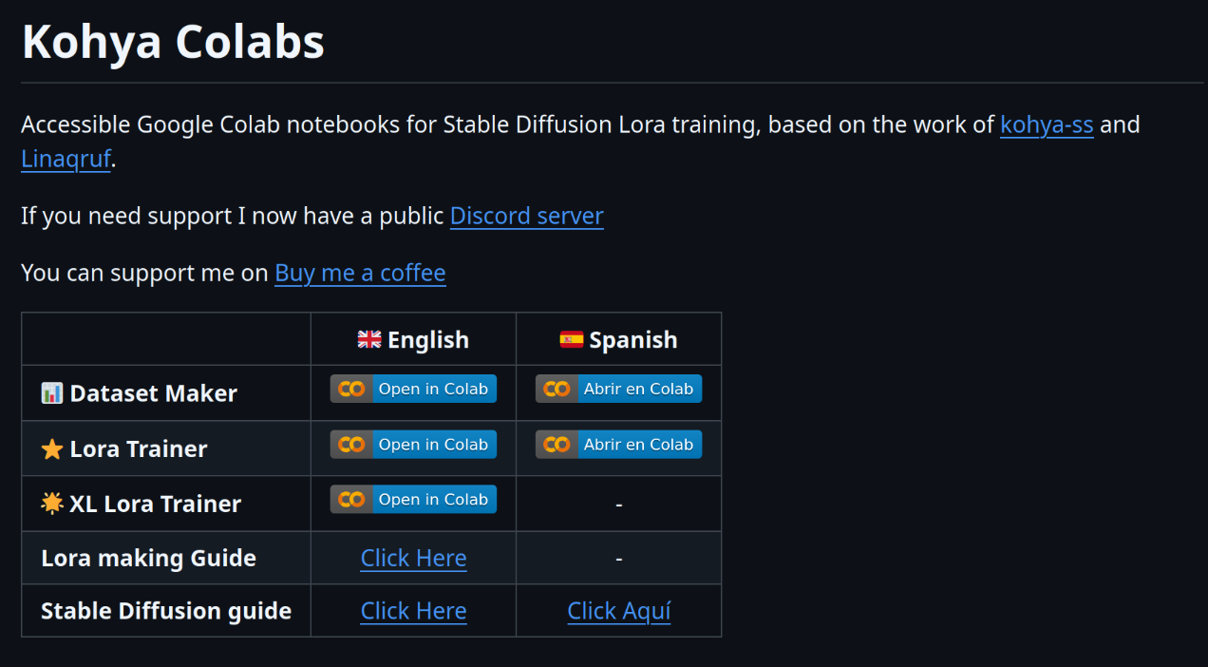
Kohya Colabs
Google Colab is a free cloud service that allows the sharing of Jupyter notebook files that can be run remotely on google’s servers
Provide Nvidia GPUs for limited amounts of time for free users
Such a notebook for kohya_ss exists, and that’s what I used to train my LoRA
Saves all data to your google drive ⇒ Easy to move across multiple PCs
https://github.com/hollowstrawberry/kohya-colab

Slide 13
What the code looks like
(Switch to my laptop and show the workspace)

Slide 14
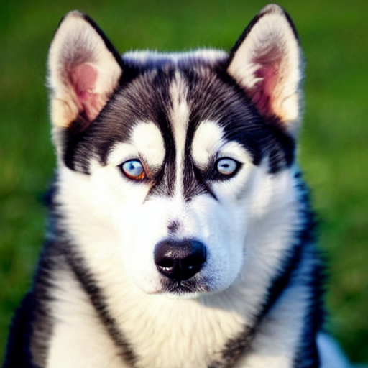
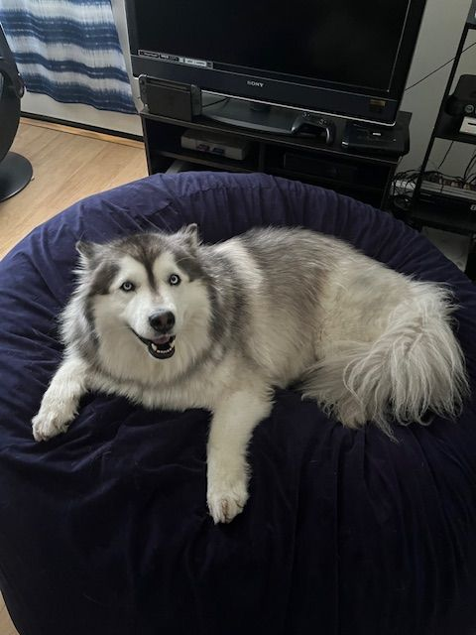
What are the actual results?
Preliminary
Before I trained my LoRA, I got some initial data of trying to recreate my dog using only text-based prompts using SD 1.5
(Real photo)

Slide 15
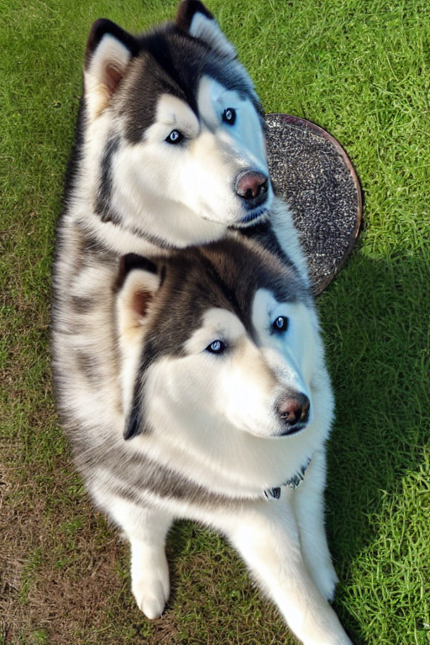
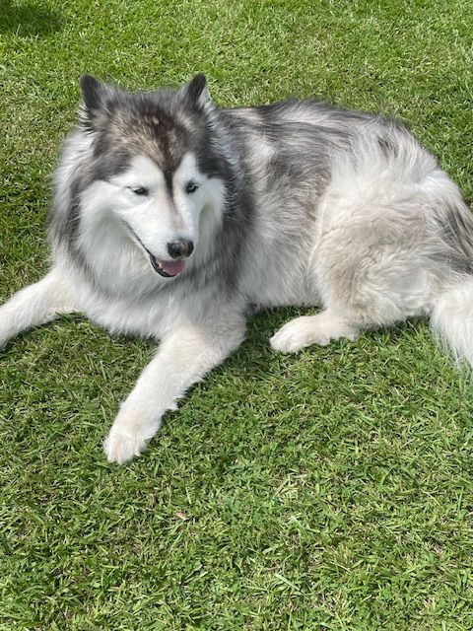
What are the actual results?
Version 1
Using the same prompt as the previous image, this is the result I got when I used the same prompt with my own LoRA enabled with a weighting of 1
(Real photo)
Small details make this much more similar to my dog than the preliminary image
Small problem, she does have two heads…

Slide 16
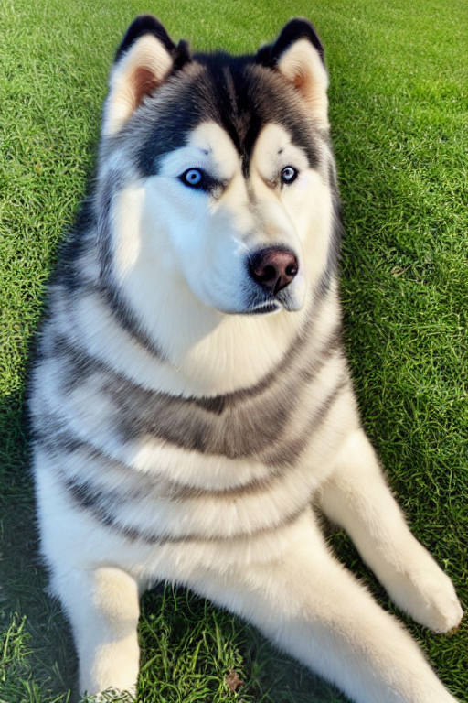
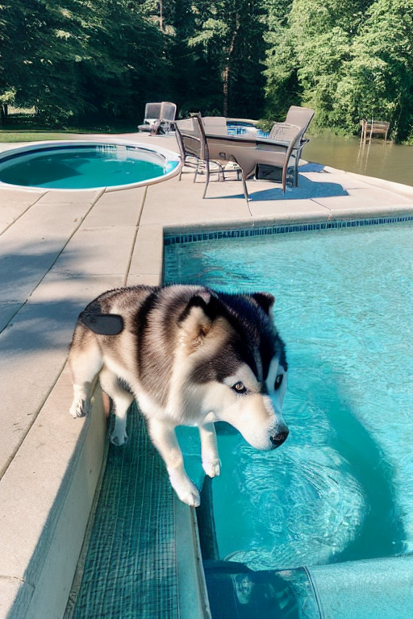
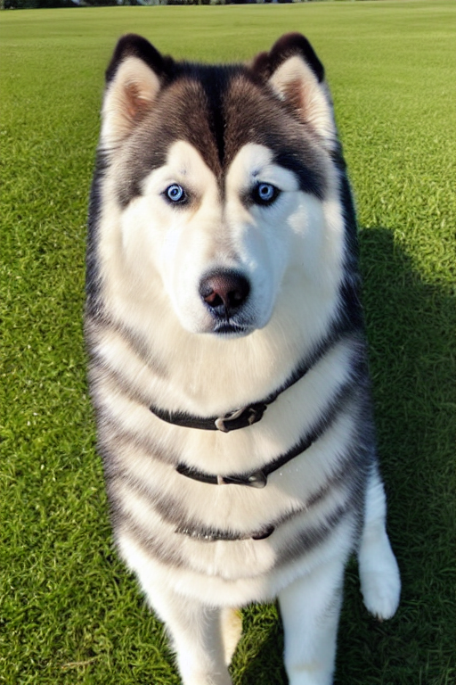
What are the actual results?
Version 1 Pros and Cons
Pros:
Took only 10 minutes to train on Kohya Colabs
Stuck to my 16 picture limit
Had only an 18mb file size for a noticeable improvement over standard SD 1.5
Cons:
Had trouble with body shape
Eyes are blurry
Had that soft, airbrushed look

Slide 17
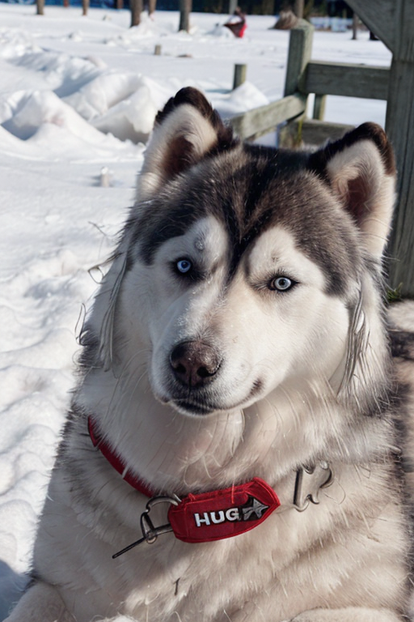
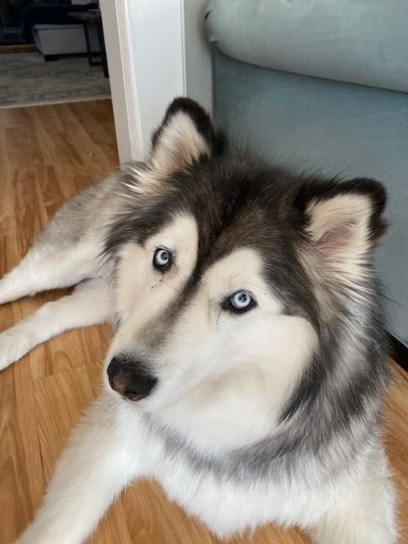
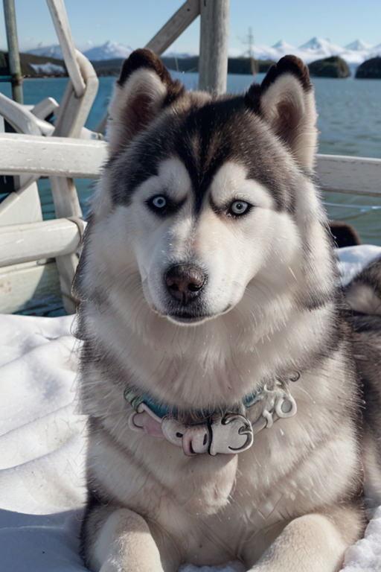
What are the actual results?
Version 1 Addendum
I also ran version 1 on a model specifically trained on photographs (analogMadness v7)
Here are the results - Better in some ways, especially in the more complex backgrounds
(Real photo)

Slide 18
What are the actual results?
Version 2 Improvements/Changes
I changed how I trained Version 2 from Version 1
I trained with images rescaled to 768x768 versus 512x512
I used AdamW optimiser rather than AdamW 8bit
I ran for 10 epochs with 14 repeats each versus 6 epochs with 10 repeats each
A batch size of 2 was used for Version 2 rather than a batch size of 3
The dataset remained the same 16 images with slightly tweaked captions (added more about background detail to help keep the subject in focus)
This meant that version 2 ended up taking around 50 minutes to train rather than the 10 minutes of version 1
However, Version 2 still keeps the small 18MB file size

Slide 19
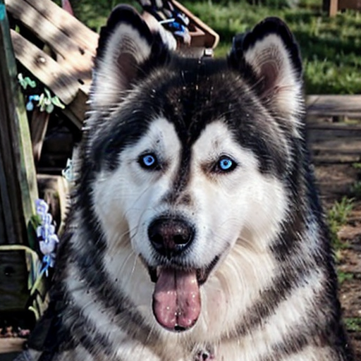
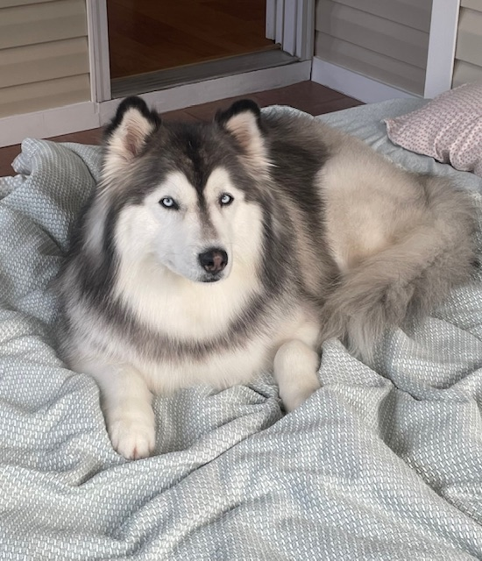
What are the actual results?
Version 2 w/ AnalogMadness v7
(Real Photo)

Slide 20
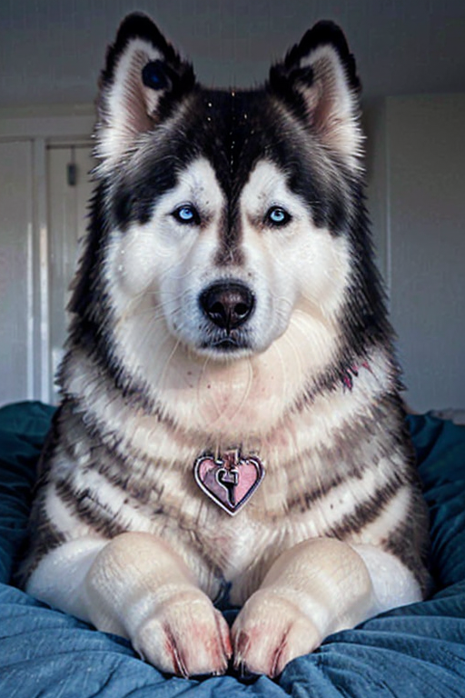
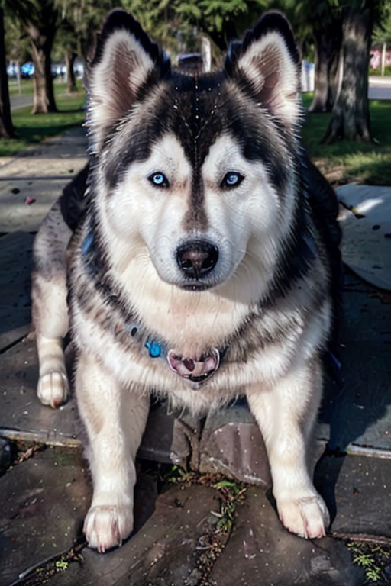
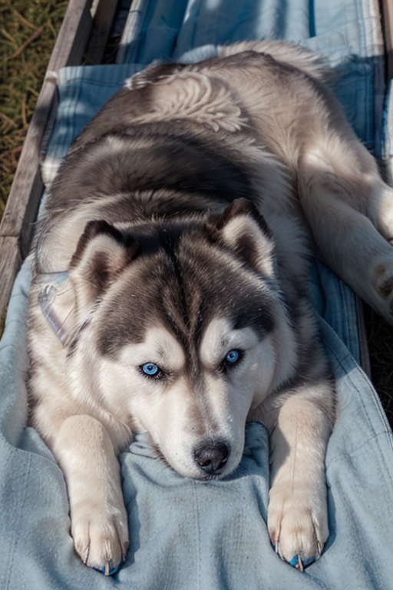
What are the actual results?
Version 2 extra

Slide 21
Conclusion
Main takeaways
LoRAs can be an effective tool for making a specific beings in Stable Diffusion, and it isn’t necessarily any less effective with an animal rather than a human subject
Kohya Colab is a really great way to train LoRAs without having a beefy Nvidia GPU of your own
Things I’d change for next time
Sacrifice a bit of file size to add more images and captions
Use a more modern stable diffusion version (Either SD 2.1, or Stable Diffusion XL for larger photos and resolution support)
I’d train using a more photorealistic model rather than a base, generic model (Thinking how I used Analog Madness v7 as a base my LoRA ran on top of, but didn’t think to train with it)
Try to crop photos down for a more square resolution (Generally, square resolution photos tended to look better than the photos with a more phone-like aspect ratio)

